Slide 1



Linked List
swatimali@somaiya.edu

Slide 2
Outline
Linked List – concept
Linked list representation
Linked list vs Array
Linked List types
Linked List implementations
Linked List applications
Summary
Queries?

Slide 3
Linked List
Random insertions and deletions anywhere in the data structure
A linked list is kind of like a scavenger hunt. You have a clue, and that clue has a pointer to place to find the next clue. So you go to the next place and get another piece of data, and another pointer. To get something in the middle, or at the end, the only way to get to it is to follow this list from the beginning (or to cheat ;) )¹
1:Courtesy: https://stackoverflow.com/questions/644167/what-is-a-practical-real-world-example-of-the-linked-list

Slide 4
What is this good for ?
Reservations/admissions and cancellations
Todo/shopping lists
Train cars are linked in a specific order so that they may be loaded, unloaded, transferred, dropped off, and picked up in the most efficient manner possible.
message delivery on network (message is broken into packets and each packet has a key of the next one so that at the receiver's end , it will be easy to club them) –SLL
Escalator
Time sharing problem used by the scheduler during the scheduling of the processes in the Operating system.

Slide 5
A Linked List
Definition:
An ordered collection of homogenous data items
Where elements can be added anywhere and removed from anywhere
Operations:
Create an empty linked List
check if it is empty
Insert: add an element at the desired position
Delete: remove the desired element
Destroy : remove all the elements one by one and destroy the data structure

Slide 6
Linked List Representation
Node representation
Array representation
Index | Data | Address
0 | S | 5
1
2 | P | 0
3 | A | 6
4
5 | M | -1
6 | T | 2
Head
A
T
P
S
M
Head= 3

Slide 7
Linked List Vs Array
Student assignment

Slide 8
Types of Linked Lists
Singly linked list- can be traversed only in one direction
Circular linked list- last node is connected to first node
Doubly linked list – can be traversed in both directions

Slide 9
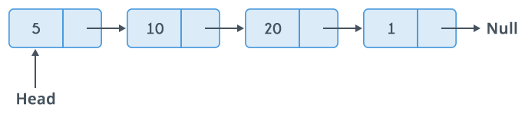
Singly linked list
Image courtesy: GeeksforGeeks.org

Slide 10
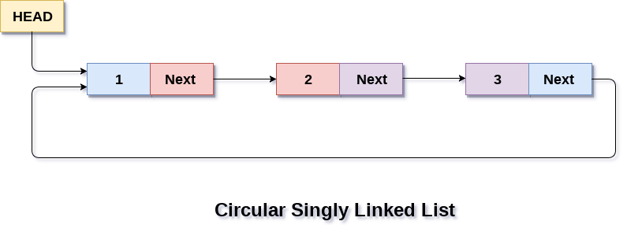
Circular Linked list
Image courtesy: GeeksforGeeks.org

Slide 11
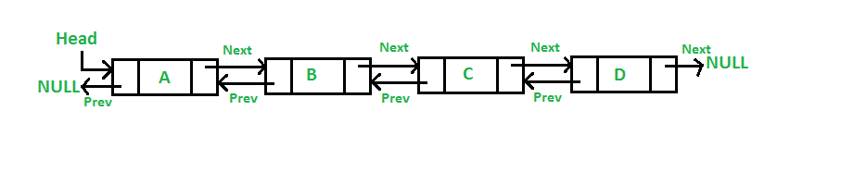
Doubly Linked list
Image courtesy: GeeksforGeeks.org

Slide 12
Singly Linked List

Slide 13
Linked Lists
Sorted/ordered linked list
Elements are inserted in sorted order
Deletions as per user requirements
Unsorted/unordered linked list
Elements are inserted and deleted as per user requirements
E.g. insertion in the beginning, in the end, before an element, after an element, etc

Slide 14
Linked Lists
Sorted linked list
Unsorted linked list
Insert(26), insert(54), insert(10), delete(26), insert(98), insert(76), delete(10), delete(54), insert(2)

Slide 15
Implementing Linked List
Struct NodeType{
ElementType Element;
struct NodeType *Next;
}
Algorithm LLType CreateLinkedList()
//This Algorithm creates and returns an empty Linked List, pointed by a pointer -head
{ createNode(head);
head=NULL;
}
Head

Slide 16
Implementing Queue: unordered Linked List
2. LLType Insert(LLType Head, NodeType NewNode)
// This Algorithm adds a NewNode at the desired position in the linked list. Head is the pointer that points to the first node in the linked list
{ if (head==NULL) // first element in Queue
NewNode->Next = NULL;
head=NewNode;
Else // General case: insertion before head, in the end, in between
}

Slide 17
Insertion in Linked List
Unsorted list
Sorted list

Slide 18
Inserting a new node
Possible cases of InsertNode
Insert into an empty list
Insert in front
Insert at back
Insert in middle
But, in fact, only need to handle two cases
Insert as the first node (Case 1 and Case 2)
Insert in the middle or at the end of the list (Case 3 and Case 4)

Slide 19
Insertion Description
Insertion at the top of the list
Insertion at the end of the list
Insertion in the middle of the list

Slide 20
Insertion Description
Insertion at the top of the list
Insertion at the end of the list
Insertion in the middle of the list

Slide 21
Insertion at the top
Steps:
Create a Node
Set the node data Values
Connect the pointers

Slide 22


Insertion Description
head
48
17
142
//
Follow the previous steps and we get
Step 1
Step 2
Step 3
head
93

Slide 23
Insertion Description
Insertion at the top of the list
Insertion at the end of the list
Insertion in the middle of the list

Slide 24
Insertion at the end
Steps:
Create a Node
Set the node data Values
Connect the pointers

Slide 25



Insertion Description
head
48
17
142
//
Follow the previous steps and we get
Step 1
Step 2
Step 3

Slide 26
Insertion Description
Insertion at the top of the list
Insertion at the end of the list
Insertion in the middle of the list

Slide 27
Insertion in the middle
Steps:
Create a Node
Set the node data Values
Break pointer connection
Re-connect the pointers

Slide 28




Insertion Description
Step 1
Step 2
Step 3
Step 4

Slide 29
Implementing unordered Linked List.. contd
3. Algorithm LLType Insert(LLType Head, NodeType NewNode)
Case 1: insertion before the head
Newnode->next=Head;
Head=Newnode ;
Case 2: insertion after the last
Struct nodeType *temp;
Temp=head;
While(temp->next!=NULL)
Temp=temp->next;
Temp->next = Newnode;
}

Slide 30
if (LL==Null) //inserting the first element
LL=Newnode; exit(0)
temp=LL, prev=null
while((newnode->data > temp->data) && temp!=Null)
{ prev=temp;
temp=temp->next;
}
if(temp==Null) //insertion in the end
Prev->next=Newnode;
if( temp=LL && newnode->data < temp->data)
{ Newnode ->next=temp; LL=Newnode }
Else // general case
Newnode->next =temp;
prev->next = Newnode

Slide 31
Implementing unordered Linked List.. contd
3. Algorithm LLType Insert(LLType Head, NodeType NewNode)
Case 3: insertion before some node (Key)
struct NodeType *temp;
Temp=Head; Prev = Null;
While(temp->data!=key && temp!=Null)
prev=temp; temp=temp->next;
If(temp==Null) “Key not found”
Else
newnode->next=temp;
Prev->next=temp;
Case 2: insertion after some node(Key)
Struct nodeType *temp;
While(temp->data!=key && temp!=Null)
temp=temp->next;
If(temp==Null) “Key not found”
Else
Newnode->next =temp->next;
Temp->next = Newnode;
}

Slide 32
Implementing Linked List
3. Algorithm ElementType Delete(LLType Head, ElementType ele)
//This algorithm returns ElementType ele if it exists in the List, an error message otherwise. Temp and current are the a temproary nodes used in the delete process.
{ if (Head==NULL)
Print “Underflow”
exit;
Else
{0. search for element
1. element doesn’t exist in list
2. deletion in unsorted list
3. deletion in sorted list
}
}

Slide 33
Deleting a node
Operation DeleteNodex)
Delete a node with the value equal to x from the list.
If such a node is found, return its position. Otherwise, return 0.
Steps
Find the desirable node (similar to FindNode)
Release the memory occupied by the found node
Set the pointer of the predecessor of the found node to the successor of the found node
Like InsertNode, there are two special cases
Delete first node
Delete the node in middle or at the end of the list
Delete the last remaining node in the list

Slide 34
Deletion Description
Deleting from the top of the list
Deleting from the end of the list
Deleting from the middle of the list

Slide 35
Deletion Description
Deleting from the top of the list
Deleting from the end of the list
Deleting from the middle of the list

Slide 36
Deleting from the top
Steps
Break the pointer connection
Re-connect the nodes
Delete the node

Slide 37
Deletion Description
head
6
4
17
42
head
6
4
17
42
head
4
17
42

Slide 38
Deletion Description
Deleting from the top of the list
Deleting from the end of the list
Deleting from the middle of the list

Slide 39
Deleting from the end
Steps
Break the pointer connection
Set previous node pointer to NULL
Delete the node

Slide 40
Deletion Description
head
6
4
17
42
head
6
4
17
42
head
6
4
17

Slide 41
Deletion Description
Deleting from the top of the list
Deleting from the end of the list
Deleting from the middle of the list

Slide 42
Deleting from the Middle
Steps
Set previous Node pointer to next node
Break Node pointer connection
Delete the node

Slide 43
Deletion Description
head
4
17
42
head
4
17
42
head
4
42

Slide 44
Implementing unordered Linked List
3. Algorithm NodeType Search(LLType Head, ElementType Key)
//This algorithm returns NodeType node which contains the ‘keyvalue” being searched.
{ if (Head==NULL)
Print “element doesn’t exist”
exit;
Else
}

Slide 45
Insertion into ordred LL
{
//case 1: insertion into empty LL
if (Head==Null)
Head=Newnode
Else
{Temp=Head, prev=Null
while(Temp->data < Newnode->data && temp!=Null)
Prev=Temp; Temp=Temp->next
//Case 2: insertion before first node
if(Prev==Null)
{ Newnode->next=Head;
Head=Newnode;
}
else //General case
{
Newnode->next=temp;
Prev->next=Newnode
}
}//InsertOrdredLL

Slide 46
DeleteOrdredLL
{
If (Head==Null)
{ Print Underflow..; Exit();
Else
{ //Search the node
Temp=Head, Prev=Null
While(Temp->data <Key)
Prev=Temp; Temp=Temp->next
if(Temp->data) != Key) //Value not found
Print Error, Exit(0)
Elseif(temp->data ==Key && Prev=Null)//Deleting first element
Head=Head->next
Elseif(Temp->data==key && Temp->next==NULL)// Deleting only element in LL
Head=Null
Else //General case, including deleting last element
Prev->next=Temp->next
}//Else
Return Temp;
}

Slide 47
Variations of Linked Lists
Circular linked lists
The last node points to the first node of the list
How do we know when we have finished traversing the list? (Tip: check if the pointer of the current node is equal to the head.)
A
B
C
Head

Slide 48
Variations of Linked Lists
Doubly linked lists
Each node points to not only successor but the predecessor
There are two NULL: at the first and last nodes in the list
Advantage: given a node, it is easy to visit its predecessor. Convenient to traverse lists backwards
∅
A
B
C
∅
Head

Slide 49
Joseph’s Problem
There are n people standing in a circle waiting to be executed. The counting out begins at some point in the circle and proceeds around the circle in a fixed direction. In each step, a certain number of people are skipped and the next person is executed. The elimination proceeds around the circle (which is becoming smaller and smaller as the executed people are removed), until only the last person remains, who is given freedom. Given the total number of person = n and a number k which indicates that k-1 persons are skipped and kth person is killed in circle.

Slide 50
Joseph’s Problem
Given the people = {Arya, Jon, Robb, Catelyn, Rose, Bran, Tyrion, Cersei, Sansa, Brienne}
k=4, Figure out name of the surviving person assuming that they are standing in the same sequence as given in the set. Show the solution step by step.

Slide 51
Array versus Linked Lists
Linked lists are more complex to code and manage than arrays, but they have some distinct advantages.
Dynamic: a linked list can easily grow and shrink in size.
We don’t need to know how many nodes will be in the list. They are created in memory as needed.
In contrast, the size of a C++ array is fixed at compilation time.
Easy and fast insertions and deletions
To insert or delete an element in an array, we need to copy to temporary variables to make room for new elements or close the gap caused by deleted elements.
With a linked list, no need to move other nodes. Only need to reset some pointers.

Slide 52
Circular Linked List

Slide 53
Circular Linked Lists
A Circular Linked List is a special type of Linked List
It supports traversing from the end of the list to the beginning by making the last node point back to the head of the list
A Rear pointer is often used instead of a Head pointer
10
20
40
55
70
Head

Slide 54
Motivation
Circular linked lists are usually sorted
Circular linked lists are useful for playing video and sound files in “looping” mode
They are also a stepping stone to implementing graphs

Slide 55
Implementing Circular Linked List
Struct NodeType{
ElementType Element;
NodeType *Next;
}
Algorithm CLLType CreateCLL()
//This Algorithm creates and returns an empty Circular Linked List, pointed by a pointers- Head
{ createNode(Head);
Head =NULL;
}
head

Slide 56
Insertion Description
Insertion at the top of the list
Insertion at the end of the list
Insertion in the middle of the list

Slide 57
Insert Node
Insert into an empty list
CreateNode(NewNode)
If(Head==Null)
{
Head = NewNode;
Head->next = Head;
}
10
NewNode
Head

Slide 58
Insert to head of a Circular Linked List
Add NewNode before Head
Locate last node and make its next point to new node
10
20
40
55
70
New
Head

Slide 59
Insert to middle of a Circular Linked List between Temp and Current
10
20
55
70
40
Head
Current
Temp
NewNode

Slide 60
Insert to end of a Circular Linked List
Find the position for NewNode
Check if its after last node
Connect NewNode’s next field to Head
10
20
40
55
70
temp
NewNode
Head

Slide 61
Deletion Description
Deleting from the top of the list
Deleting from the end of the list
Deleting from the middle of the list

Slide 62
Doubly Linked Lists
In a Doubly Linked List each item points to both its predecessor and successor
prev points to the predecessor
next points to the successor
10
20
40
55
70
Head
Cur->prev
Cur
Cur->next

Slide 63
Motivation
Doubly linked lists are useful for playing video and sound files with “rewind” and “instant replay”
They are also useful for other linked data which require “rewind” and “fast forward” of the data

Slide 64
Doubly Linked List Definition
struct Node{
int data;
Node* next;
Node* prev;
};
Node* Head, List1, List2;

Slide 65
Insertion into DLL
1. initialize data structure
CreateNode(Head);
Head=NULL
Search // searching in sorted list for insertion operation
temp=Head
while(NewNode->data > temp->data && temp->next!=Null)
temp=temp->next;
2. Insertion
createNode(NewNode) // CreateNode creates a node, adds data
to it and assigns both addresses NULL value
2A. insertion of first node
if(Head==NULL)
head=NewNode;

Slide 66
2B. insertion at the end
if(NewNode->data > temp->data && temp->next==Null)
{ NewNode->prev = temp
temp->next= NewNode
}
2C. Insert before the head node
if(NewNode->data < temp->data && temp==Head)
{ NewNode->next = temp;
temp->prev = NewNode
Head= Newnode;
}
2D. Insertion in between
{
NewNode-> Next = temp;
NewNode -> prev = temp->prev
temp-> prev->next= NewNode
temp->prev = NewNode
}

Slide 67
Deletion in DLL
1. Deletion from empty DLL
1A. Element doesn't exist
2. Deletion of last/only node in DLL
3. Deletion of Head node
4. Deletion of last node
5. General case

Slide 68
Deletion in DLL
1. if (Head==Null)
Print" Underflow.. Error“
//Search
temp=Head
while( temp!=Null && Temp->data <SearchKey)
temp=temp-> next

Slide 69
Deletion in DLL
1A. // unsuccessful search e.g. SearchKey ==1 or 30 or 500
if(Temp->data > SearchKey || (temp-> next ==Null && temp->data <SearchKey)) )
print "Element does not exist"
2. Deletion of only node in list
if(temp->data == SearchKey && temp=Head && temp->next ==NULL)
{ Head=NULL;
return(Temp)
}
4. //e.g. SearchKey= 100 Deletion of last node
if(temp->data == SearchKey && temp->next ==NULL)
{ temp->prev->next = NULL
return(temp)
}

Slide 70
3. Deletion in general
{ temp->next->prev= temp->prev
temp->prev->next= temp->next
}
5. Deletion of first node in list
if(temp==head && temp->data == SearchKey)
{ head=head->next
temp->next->prev= NULL
return(temp)
}

Slide 71
Advantages of Linked Lists
The advantages of linked lists include:
Overflow can never occur unless the memory is actually full.
Insertions and deletions are easier than for contiguous (array) lists.
With large records, moving pointers is easier and faster than moving the items themselves.

Slide 72
Disadvantage of Linked Lists
The disadvantages of linked lists include:
The pointers require extra space.
Linked lists do not allow random access.
Time must be spent traversing and changing the pointers.
Programming is typically trickier with pointers.

Slide 73
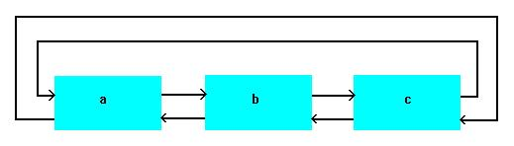
Homework: Circular doubly linked list

Slide 74
Queries?

Slide 75
Thank you!

